Slide 1
BIOMEDICAL INSTRUMENTATION
MODULE-4 Part-2
PROF. DR. JOYANTA KUMAR ROY
DEPARTMENT OF APPLIED ELECTRONICS & INSTRUMENTATION ENGINEERING
NARULA INSTITUTE OF TECHNOLOGY
WWW.dr-joyanta-kumar–roy.com

Slide 2
Subjects of discussion
Medical imaging
Ultrasonography (USG)
Medical Thermography (IR)
The Module -3 part-2 course duration : 1 lecture
The lecture content will be available at http//www.dr-joyanta-kumar-roy.com

Slide 3
THERMAL IMAGING SYSTEM
Medical Thermography

Slide 4
INFRA RAY - Physics behind it…….
Radiography provides essential information on anatomical structures and abnormalities while Thermography indicates metabolic process and circulation changes.
The Human body absorbs all most all infra red radiation but it also emits part of its own Thermal energy in the form of infrared radiation.
Thermography is the technology of visualising the radiation pattern of the human organ brought about by pathologicval changes and is a real time system

Slide 5
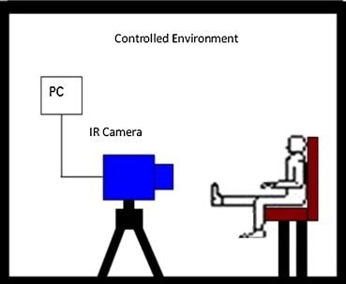
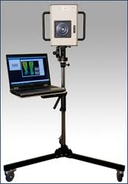
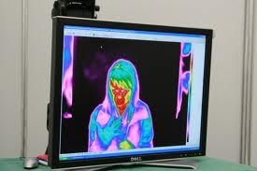
This equipment usually has two parts, the IR camera and a standard PC or laptop computer. These systems have only a few controls and relatively easy to use.
Monitors are high-resolution full colour, isotherm or grey scale, and usually include image manipulation, isothermal temperature mapping, and point-by-point temperature measurement with a cursor or statistical region of interest. The systems measure temperatures ranging from 10° C - 55° C to an accuracy of 0.1° C. Focus adjustment should cover small areas down to 75 x 75mm.

Slide 7
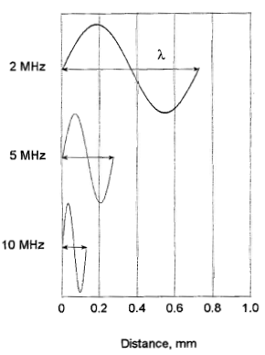
1. Characteristics of Ultra Sonic sound Wave length, frequency and speed
The ultrasound frequency is unaffected by changes in sound speed as the acoustic beam propagates through various media
Thus, the ultrasound wavelength is dependent on the medium (c = λf )
A change in speed at an interface between two media causes a change in wavelength
Higher frequency sound has shorter wavelength

Slide 8
1. Characteristics of Sound Pressure, Intensity and the dB scale
The amplitude of a wave is the size of the wave displacement
Larger amplitudes of vibration produce denser compression bands and, hence, higher intensities of sound
Intensity of ultrasound
is the amount of power (energy per unit time) per unit area
proportional to the square of the pressure amplitude, I ∝ P2
units of milli watts/cm2 or mW/cm2
is measured in decibels (dB) as a relative intensity
dB = 10 log10 (I2/I1) or dB = 20 log10 (P2/P1) since I ∝ P2
I1 and I2 are intensity values
P1 and P2 are pressure or amplitude variations
1 B = 10 dB where B is bels

Slide 9
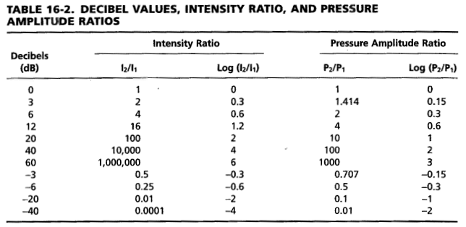
1. Characteristics of Ultrasonic Sound Pressure, Intensity and the dB scale
c.f. Bushberg, et al. The Essential Physics of Medical Imaging, 2nd ed., p. 476.

Slide 10
1. Characteristics of Ultra sonic Sound – Key Points
Propagation of sound - Key Points
Speed of sound is dependent on the medium
Ultrasound frequency is independent of the medium, and does not change
Wavelength changes with the changes of speed
c [m/sec] = λ [m] * f [1/sec]
For most calculations, the average speed of sound in soft tissue, 1540 m/sec, should be assumed
In air = 330 m/sec and in fatty tissue = 1450 m/sec
dB = 10 log10 (I2/I1)

Slide 12
2. Interactions of Ultrasound with Matter
Ultrasound interactions are determined by the acoustic properties of matter
As ultrasound energy propagates through a medium, interactions that occur include
reflection
refraction
scattering
Absorption (attenuation)

Slide 13
2. Interactions of Ultrasound with Matter Acoustic Impedance
Acoustic Impedance, Z
is equal to density of the material times speed of sound in the material in which ultrasound travels, Z = ρ c
ρ = density (kg/m3) and c = speed of sound (m/sec)
measured in rayl (kg/m2sec)
Air and lung media have low values of Z, whereas bone and metal have high values
Large differences in Z (air-filled lung and soft tissue) cause reflection, small differences allow transmission of sound energy
The differences between acoustic impedance values at an interface determines the amount of energy reflected at the interface
c.f. Bushberg, et al. The Essential Physics of Medical Imaging, 2nd ed., p. 477.

Slide 14
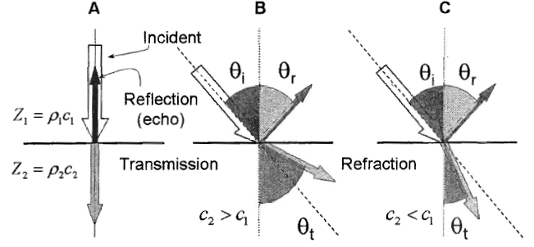
2. Interactions of Ultrasound with Matter Reflection
A portion of the ultrasound beam is reflected at tissue interface
The sound reflected back toward the source is called an echo and is used to generate the ultrasound image
The percentage of ultrasound intensity reflected depends in part on the angle of incidence of the beam
As the angle of incidence increases, reflected sound is less likely to reach the transducer
c.f. Bushberg, et al. The Essential Physics of Medical Imaging, 2nd ed., p. 478.

Slide 15
2. Interactions of Ultrasound with Matter Reflection
Sound reflection occurs at tissue boundaries with differences in acoustic impedance
The intensity reflection coefficient, R = Ir/Ii = ((Z2 – Z1)/(Z2 + Z1))2
The subscripts 1 and 2 represent tissues proximal and distal to the boundary.
Equation only applies to normal incidence
The transmission coefficient = T = 1 – R
T = (4Z1Z2)/(Z1+Z2)2
c.f. Bushberg, et al. The Essential Physics of Medical Imaging, 2nd ed., p. 479.

Slide 16
2. Interactions of Ultrasound with Matter Tissue reflections
Air/tissue interfaces reflect virtually all of the incident ultrasound beam
Gel is applied to displace the air and minimize large reflections
Bone/tissue interfaces also reflect substantial fractions of the incident intensity
Imaging through air or bone is generally not possible
The lack of transmissions beyond these interfaces results in an area void of echoes called shadowing
In imaging the abdomen, the strongest echoes are likely to arise from gas bubbles
Organs such as kidney, pancreas, spleen and liver are comprised of subregions that contain many scattering sites, which results in a speckled texture on images
Organs with fluids such as bladder, cysts, and blood vessels have almost no echoes (appear black)

Slide 17
2. Interactions of Ultrasound with Matter Refraction
Refraction is the change in direction of an ultrasound beam when passing from one medium to another with a different acoustic velocity
Wavelength changes causing a change in propagation direction (c = λf)
sin(θt) = sin(θi) * (c2/c1), Snell’s law;
for small θ ≤ 15o: θt = θi * (c2/c1)
When c2 > c1, θt > θi , When c1 > c2, θt < θi
Ultrasound machines assume straight line propagation, and refraction effects give rise to artifacts
c.f. Bushberg, et al. The Essential Physics of Medical Imaging, 2nd ed., p. 478.

Slide 18
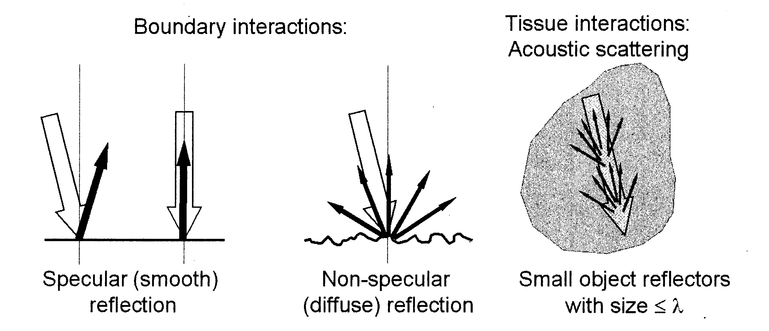
2. Interactions of Ultrasound with Matter Scatter
Acoustic scattering arises from objects within a tissue that are about the size of the wavelength of the incident beam or smaller, and represent a rough or nonspecular reflector surface
As frequency increases, the non-specular (diffuse scatter) interactions increase, resulting in an increased attenuation and loss of echo intensity
Scatter gives rise to the characteristic speckle patterns of various organs, and is important in contributing to the grayscale range in the image
c.f. Bushberg, et al. The Essential Physics of Medical Imaging, 2nd ed., p. 480.

Slide 19
2. Interactions of Ultrasound with Matter Attenuation
Ultrasound attenuation, the loss of energy with distance traveled, is caused chiefly by scattering and tissue absorption of the incident beam (dB)
The intensity loss per unit distance (dB/cm) is the attenuation coefficient
Rule of thumb: attenuation in soft tissue is approx. 1 dB/cm/MHz
The attenuation coefficient is directly proportional to and increases with frequency
Attenuation is medium dependent

Slide 20
2. Interactions of Ultrasound with Matter – Key Points
Acoustic Impedance, Z
is equal to density of the material times speed of sound in the material in which ultrasound travels, Z = ρ c
ρ = density (kg/m3) and c = speed of sound (m/sec)
As ultrasound energy propagates through a medium, interactions that occur include
reflection
refraction
scattering
Absorption (attenuation)

Slide 21
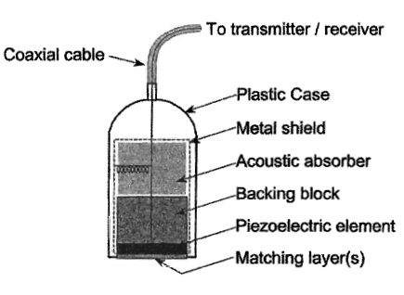
3. Transducers
A transducer is a device that can convert one form of energy into another
Piezoelectric transducers convert electrical energy into ultrasonic energy and vice versa
Piezoelectric means pressure electricity
c.f. Bushberg, et al. The Essential Physics of Medical Imaging, 2nd ed., p. 484.

Slide 22
3. Transducers
High-frequency voltage oscillations are produced by a pulse generator and are sent to the ultrasound transducer by a transmitter
The electrical energy causes the piezoelectric crystal to momemtarily change shape (expand and contract depending on current direction)
c.f. Bushberg, et al. The Essential Physics of Medical Imaging, 2nd ed., p. 484.

Slide 23
3. Transducers
This change in shape of the crystal increases and decreases the pressure in front of the transducer, thus producing ultrasound waves
When the crystal is subjected to pressure changes by the returning ultrasound echoes, the pressure changes are converted back into electrical energy signals
Return voltage signals are transferred from the receiver to a computer to create an ultrasound image
Transducer crystals do not conduct electricity but are coated with a thin layer of silver which acts as an electrode

Slide 24
3. Transducers
The piezoelectric effect of a transducer is destroyed if heated above its curie temperature limit
Transducers are made of a synthetic ceramic (peizoceramic) such as lead-zirconate-titanate (PZT) or plastic polyvinylidence difluoride (PVDF) or a composite
A transducer may be used in either pulsed or continuous-wave mode
A transducer can be used both as a transmitter and receiver of ultrasonic waves

Slide 25
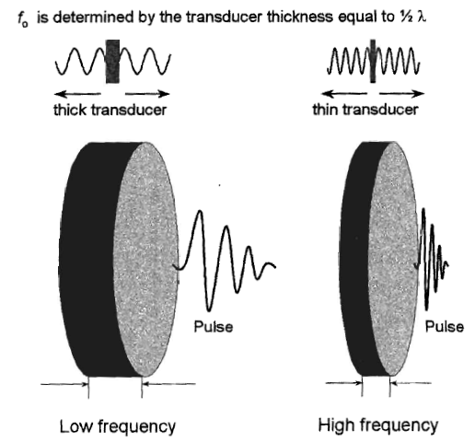
3. Transducers
The thickness of a piezoelectric crystal determines the resonant frequency of the transducer
The operating resonant frequency is determined by the thickness of the crystal equal to ½ wavelength (t=λ/2) of emitted sound in the crystal compound
Resonance transducers transmit and receive preferentially at a single “center frequency”
c.f. Bushberg, et al. The Essential Physics of Medical Imaging, 2nd ed., p. 486.

Slide 26
3. Transducers Damping Block
The damping block absorbs the backward directed ultrasound energy and attenuates stray ultrasound signals from the housing
It also dampens (ring-down) the transducer vibration to create an ultrasound pulse with a short spatial pulse length, which is necessary to preserve detail along the beam axis (axial resolution)
c.f. Bushberg, et al. The Essential Physics of Medical Imaging, 2nd ed., p. 484.

Slide 27
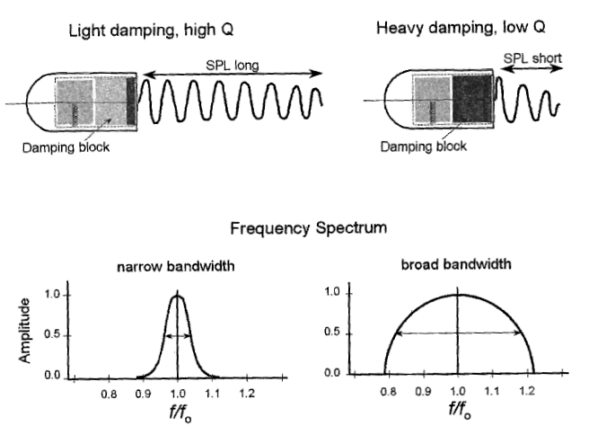
3. Transducers Q factor
The Q factor is related to the frequency response of the crystal
The Q factor determines the purity of the sound and length of time the sound persists, or ring down time
Q = operating frequency (MHz) / bandwidth (width of the frequency distribution)
Q = f0/BW
High-Q transducers produce a relatively pure frequency spectrum
Low-Q transducers produce a wider range of frequencies
c.f. Bushberg, et al. The Essential Physics of Medical Imaging, 2nd ed., p. 487.

Slide 28
3. Transducers Matching Layer
A matching layer of material is placed on the front surface of the transducer to improve the efficiency of energy transmission into the patient
The material has acoustic properties intermediate to those of soft tissue and the transducer material
The matching layer thickness is equal to ¼ the wavelength of sound in that material (quarter-wave matching)
Acoustic coupling gel is used to eliminate air pockets that could attenuate and reflect the ultrasound beam
c.f. Bushberg, et al. The Essential Physics of Medical Imaging, 2nd ed., p. 484.

Slide 29
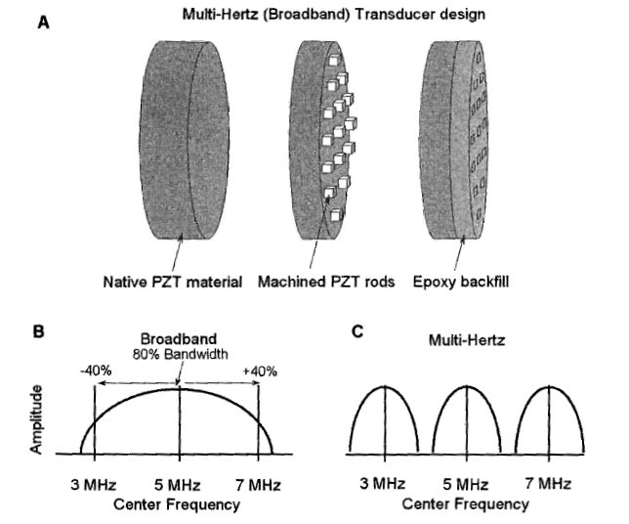
3. Transducers Nonresonance (Broad-Bandwidth) “Multifrequency” Transducers
c.f. Bushberg, et al. The Essential Physics of Medical Imaging, 2nd ed., p. 488.

Slide 30
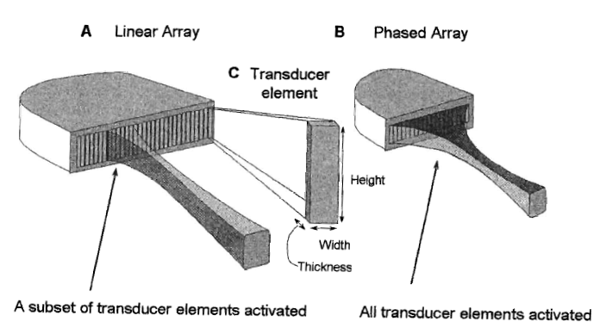
3. Transducers Transducer Arrays
c.f. Bushberg, et al. The Essential Physics of Medical Imaging, 2nd ed., p. 489.
Linear or curvilinear array transducers
256 to 512 elements
Simultaneous firing of a small group of approx. 20 elements produces the ultrasound beam
Rectangular field of view produced for linear and trapezoidal for curvilinear array transducers

Slide 31
3. Transducers Transducer Arrays
c.f. Bushberg, et al. The Essential Physics of Medical Imaging, 2nd ed., p. 489.
Phased array transducers
64 to 128 elements
All are activated simultaneously
Using time delays can steer and focus beam electronically

Slide 32
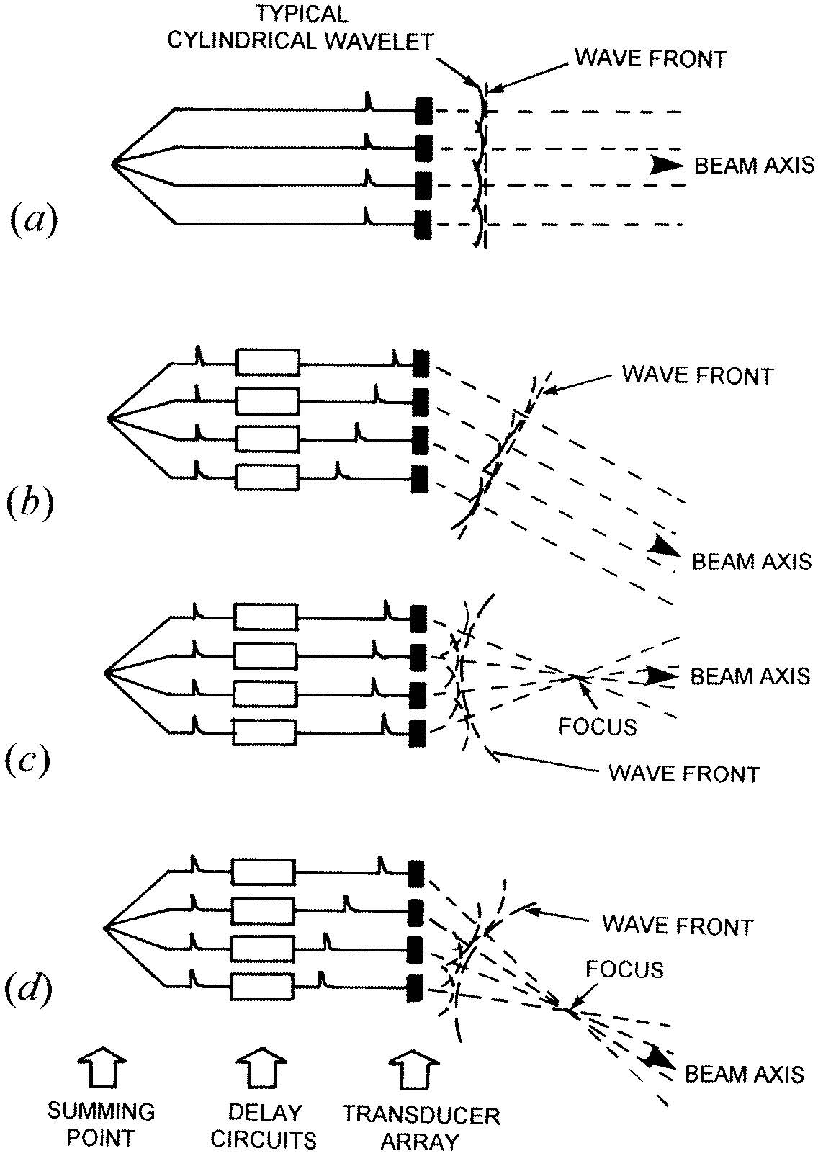

Slide 33
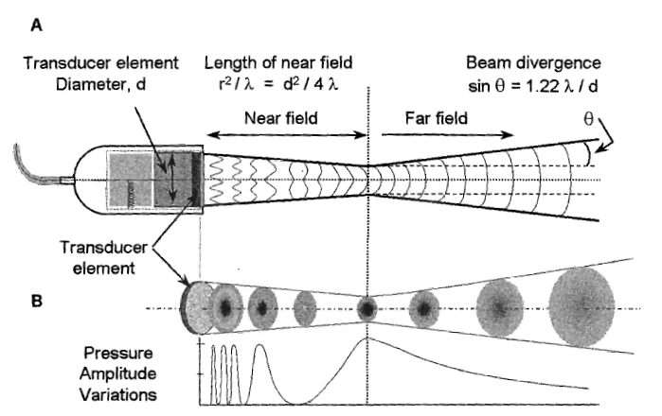
3. Ultrasound Beam Properties Near Field and Far Field
Near (parallel) Field “Fresnel zone”
Is adjacent to the transducer face and has a converging beam profile
Convergence occurs because of multiple constructive and destructive interference patterns of the ultrasound waves (pebble dropped in a quiet pond)
Near Zone length = d2/4λ = r2/λ
d=transducer diameter, r=transducer radius
c.f. Bushberg, et al. The Essential Physics of Medical Imaging, 2nd ed., p. 491.

Slide 34
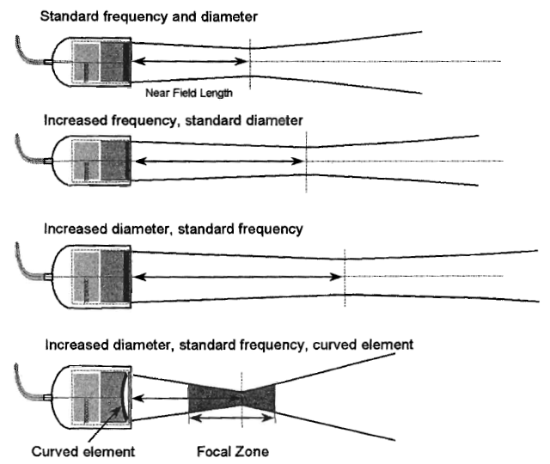
3. Ultrasound Beam Properties Near Field and Far Field
Unfocused transducer, Near Zone length = d2/4λ = r2/λ
A focused single element transducer uses either a curved element or an acoustic lens:
Reduce beam diameter
All diagnostic transducers are focused
Focal zone is the region over which the beam is focused
A focal zone describes the region of best lateral resolution
c.f. Bushberg, et al. The Essential Physics of Medical Imaging, 2nd ed., p. 492.

Slide 35
3. Ultrasound Beam Properties Near Field and Far Field
The far field or Fraunhofer zone is where the beam diverges
Angle of divergence for non-focused transducer is given by
sin(θ) = 1.22λ/d
Less beam divergence occurs with high-frequency, large-diameter transducers
c.f. Bushberg, et al. The Essential Physics of Medical Imaging, 2nd ed., p. 491.

Slide 36
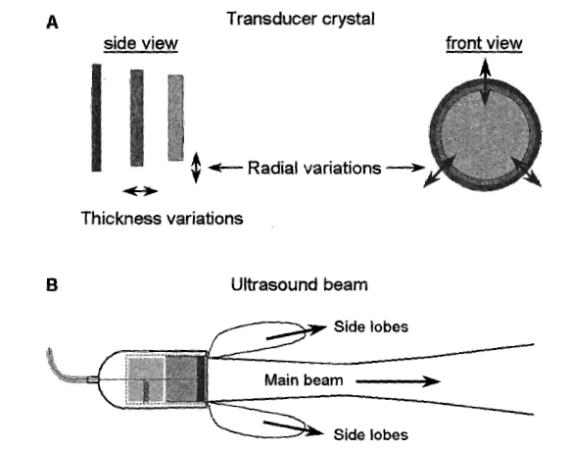
3. Ultrasound Beam Properties - Side Lobes
Side lobes are unwanted emissions of ultrasound energy directed away from the main pulse
Caused by the radial expansion and contraction of the transducer element during thickness contraction and expansion
Lobes get larger with transducer size
Echoes received from side lobes are mapped into the main beam, causing artifacts
c.f. Bushberg, et al. The Essential Physics of Medical Imaging, 2nd ed., p. 496.

Slide 37
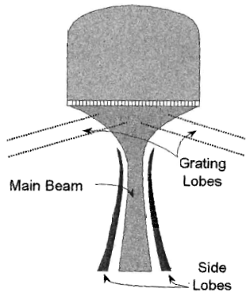
3. Ultrasound Beam Properties - Side Lobes
For multielement arrays, side lobe emission occurs in a forward direction along main beam
Grating lobes result when ultrasound energy is emitted far off-axis by multielement arrays, and are a consequence of the noncontinuous transducer surface of the discrete elements
results in appearance of highly reflective, off-axis objects in the main beam
c.f. Bushberg, et al. The Essential Physics of Medical Imaging, 2nd ed., p. 496.

Slide 38
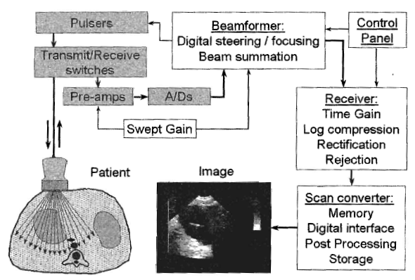
Image Data Acquisition
c.f. Bushberg, et al. The Essential Physics of Medical Imaging, 2nd ed., p. 501.

Slide 39
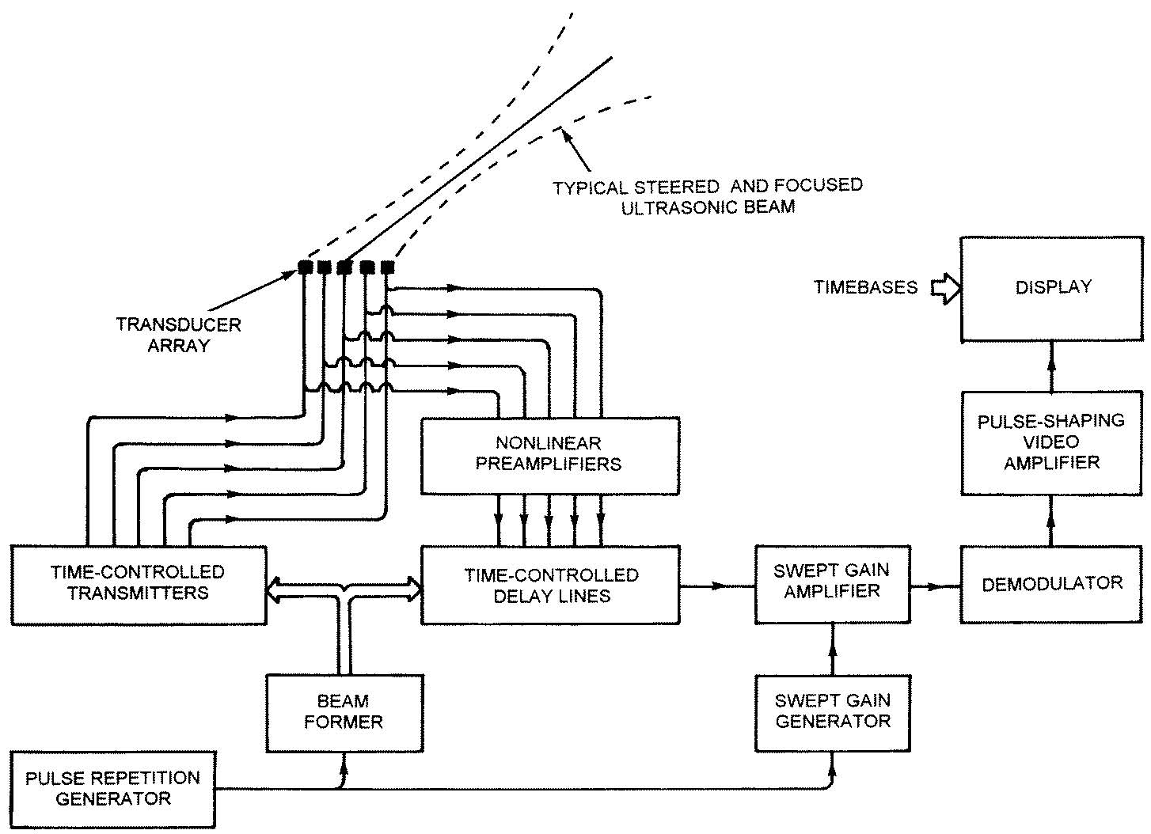

Slide 40
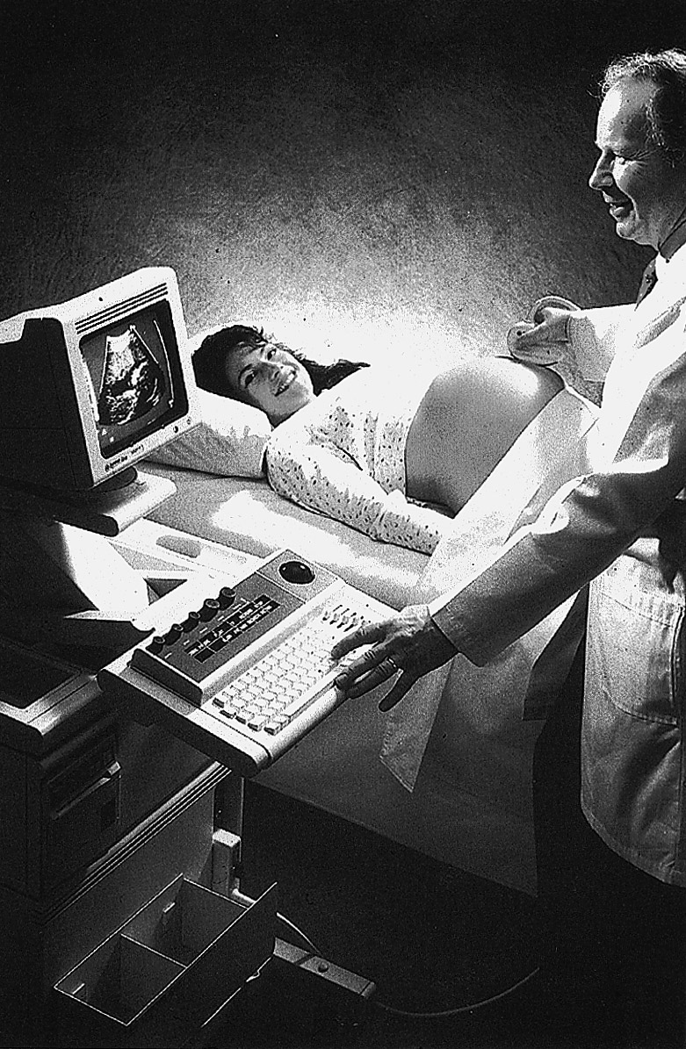

Slide 41
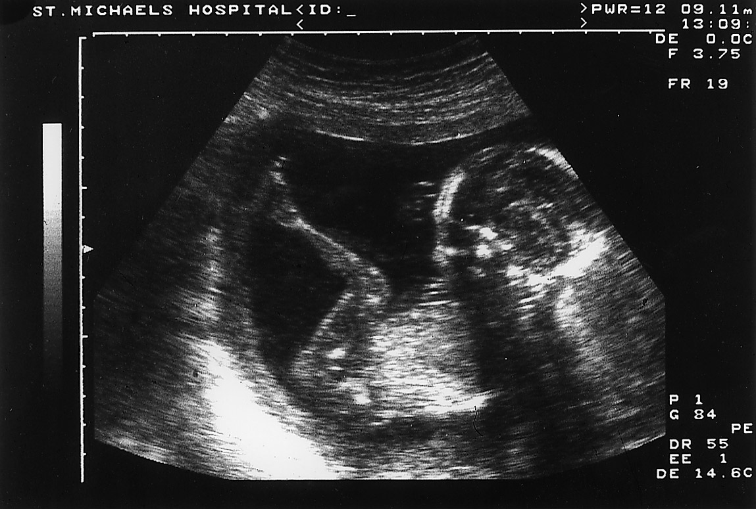

Slide 42
3. Pulse Echo Operation Pulse Repetition Frequency (PRF)
Diagnostic ultrasound utilizes a pulse-echo format using a single transducer to generate images
Most ultrasound beams are emitted in brief pulses (1-2 μs duration)
For soft tissue (c = 1540 m/s or 0.154 cm/msec), the time delay between the transmission pulse and the detection of the echo is directly related to the depth of the interface as
c = 2D / time
Time (μsec) = 2D (cm) / c (cm/ μsec) = 2D/0.154
Time (μsec) = 13 μsec x D (cm)
Distance (cm) = [c (cm/ μsec) x Time (μsec)] / 2
Distance (cm) = 0.077 x Time (μsec)

Slide 43
Key Points
Piezoelectric transducers convert electrical energy into ultrasonic energy and vice versa The thickness of a piezoelectric crystal determines the resonant frequency of the transducer The Q factor determines the purity of the sound and length of time the sound persists, or ring down time
Linear or curvilinear array transducers, phased array transducers
Near Zone length = d2/4λ = r2/λ
The far field or Fraunhofer zone is where the beam diverges, sin(θ) = 1.22λ/d
Time (μsec) = 13 μsec x D (cm) or
Distance (cm) = 0.077 x Time (μsec)
PRF = c/2D

Slide 44
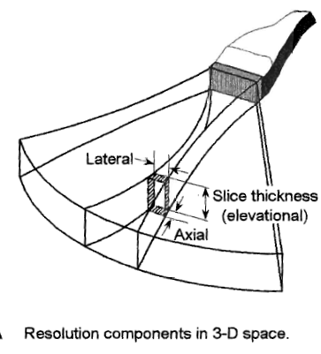
4. Spatial Resolution
Spatial resolution has 3 distinct measures: axial, lateral and slice thickness (elevational)
c.f. Bushberg, et al. The Essential Physics of Medical Imaging, 2nd ed., p. 497.

Slide 45
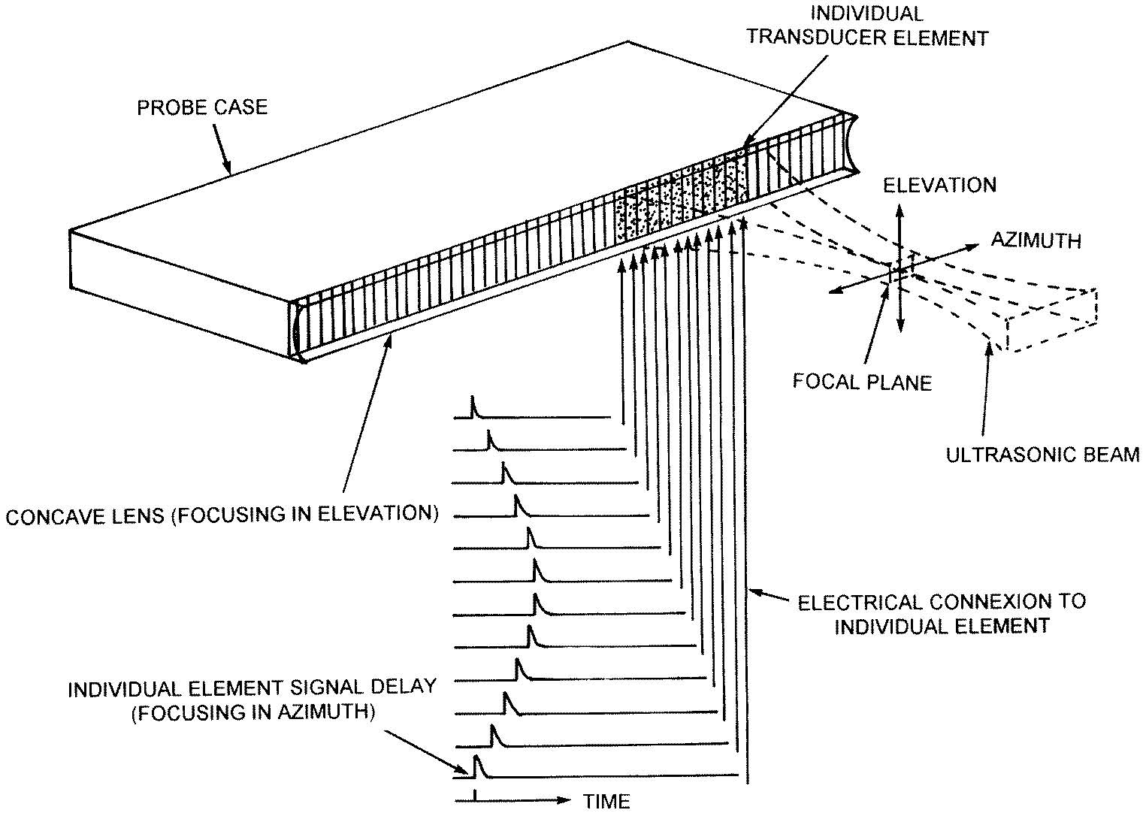

Slide 46
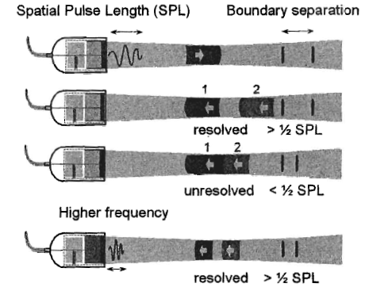
4. Spatial Resolution - Axial
Axial resolution (linear, range, longitudinal or depth resolution) is the ability to separate two objects lying along the axis of the beam
Achieving good axial resolution requires that the returning echoes be distinct without overlap
The minimal required separation distance between two boundaries is ½ SPL (about ½ λ) to avoid overlap of returning echoes
c.f. Bushberg, et al. The Essential Physics of Medical Imaging, 2nd ed., p. 498.

Slide 47
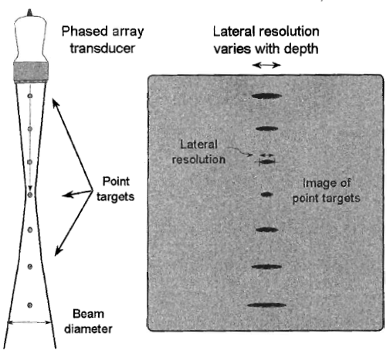
4. Spatial Resolution - Lateral
Lateral resolution - the ability to resolve adjacent objects perpendicular to the beam direction and is determined by the beam width and line density
Typical lateral resolution (unfocused) is 2 - 5 mm, and is depth dependent
Single focused transducers restrain the beam to within narrow lateral dimensions at a specified depth using lenses at the transducer face
c.f. Bushberg, et al. The Essential Physics of Medical Imaging, 2nd ed., p. 499.

Slide 48
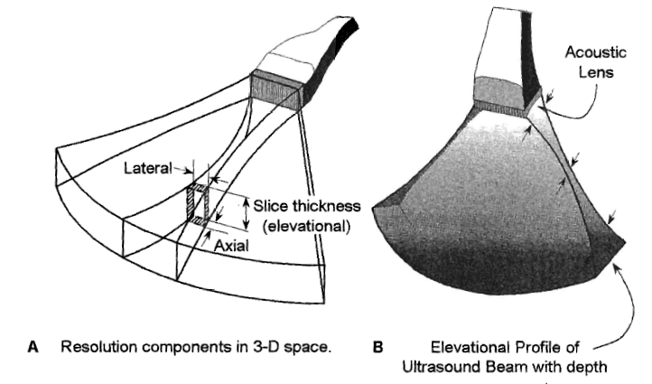
4. Spatial Resolution - Slice thickness (Elevational)
Elevational resolution is dependent on the transducer element height
Perpendicular to the image plane
Use of a fixed focal length lens across the entire surface of the array provides improved elevational resolution at the focal distance, however partial volume effects before and after focal zone
c.f. Bushberg, et al. The Essential Physics of Medical Imaging, 2nd ed., p. 497.

Slide 49
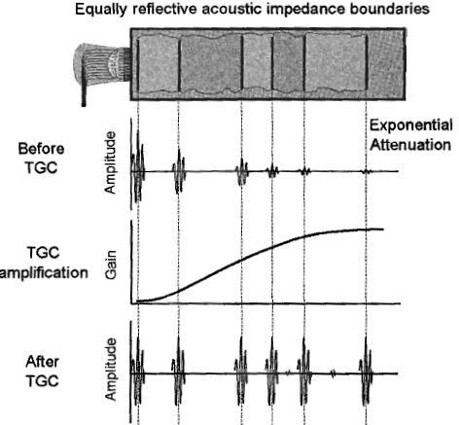
5. Display
Ultrasound scanners use time gain compensation (TGC) to compensate for increased attenuation with depth
TGC is also known as depth gain compensation, time varied gain, and swept gain
Images are normally displayed on a video monitor or stored in a computer
Generally 512 x 512 matrix size images, 8 bits deep allowing 256 gray levels to be displayed, 0.25 MB data
c.f. Bushberg, et al. The Essential Physics of Medical Imaging, 2nd ed., p. 507.

Slide 50
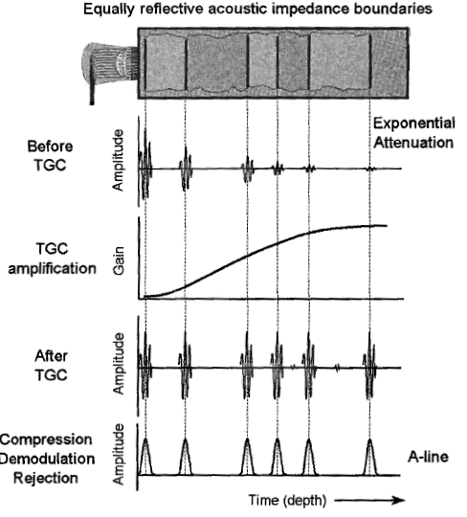
5. Display Modes: A-mode
A-mode “amplitude” mode: displays echo amplitude vs. time (depth)
One “A-line” of data per pulse repetition
A-mode used in ophthalmology or when accurate distance measurements are required
c.f. Bushberg, et al. The Essential Physics of Medical Imaging, 2nd ed., p. 507.

Slide 51
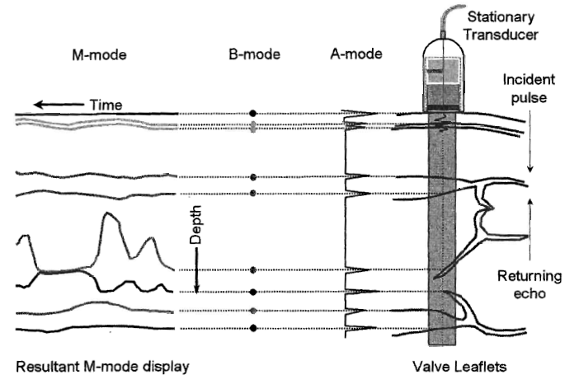
5. Display Modes: B-mode
B-mode (B for brightness) is the electronic conversion of the A-mode and A-line information into brightness-modulated dots on a display screen
In general, the brightness of the dot is proportional to the echo signal amplitude
Used for M-mode ad 2D gray-scale imaging
c.f. Bushberg, et al. The Essential Physics of Medical Imaging, 2nd ed., p. 509.

Slide 52
5. Display Modes: M-mode
M-mode (“motion” mode) or T-M mode (“time-motion” mode): displays time evolution vs. depth
Sequential US pulse lines are displayed adjacent to each other, allowing visualization of interface motion
M-mode is valuable for studying rapid movement, such as mitral valve leaflets
c.f. Bushberg, et al. The Essential Physics of Medical Imaging, 2nd ed., p. 509.

Slide 53
5. Scan Converter
The function of the scan converter is to create 2D images from echo formation received and to perform scan conversion to enable image data to be viewed on video display monitors
Scan conversion is necessary because the image acquisition and display occur in different formats
Modern scan converters use digital methods for processing and storing data
For color display, the bit depth is often as much as 24 bits or 3 bytes of primary color

Slide 54
ASSIGNMENTS
Write short note on Ultra Sono Gram (USG)
2. The wavelength of a 2 MHz ultrasound beam is ________ mm.
(A. 0.02 ,B. 0.55 ,C. 0.77 ,D. 2.0 ,E. 5.0 )
3. Calculate the remaining intensity of a 100-mW ultrasound pulse that loses 30 dB while traveling through tissue.
4. Approximately what fraction of an ultrasound beam is reflected from an interface between two media with Z values of 1.65 and 1.55?
5. What are the key points of a usg sensor
6. What are the display modes and their functions in ultrasonic imaging.

