Slide 1
BIOMEDICAL INSTRUMENTATION
MODULE-2
PROF. DR. JOYANTA KUMAR ROY
DEPARTMENT OF APPLIED ELECTRONICS & INSTRUMENTATION ENGINEERING
NARULA INSTITUTE OF TECHNOLOGY
WWW.dr-joyanta-kumar–roy.com

Slide 2
Module - 2 Fundamentals of Biomedical Instrumentation

Slide 3
General Instrumentation Knowledge
Basic Concepts of Medical Instrumentation
Origin of Bio potentials
Bio potential Electrodes
Effects of Interface Impedances
Amplifiers
Operational Amplifiers
(Basic circuit configurations, parameters, data sheets)
Instrumentation Amplifiers
Bio potential Amplifiers

Slide 4
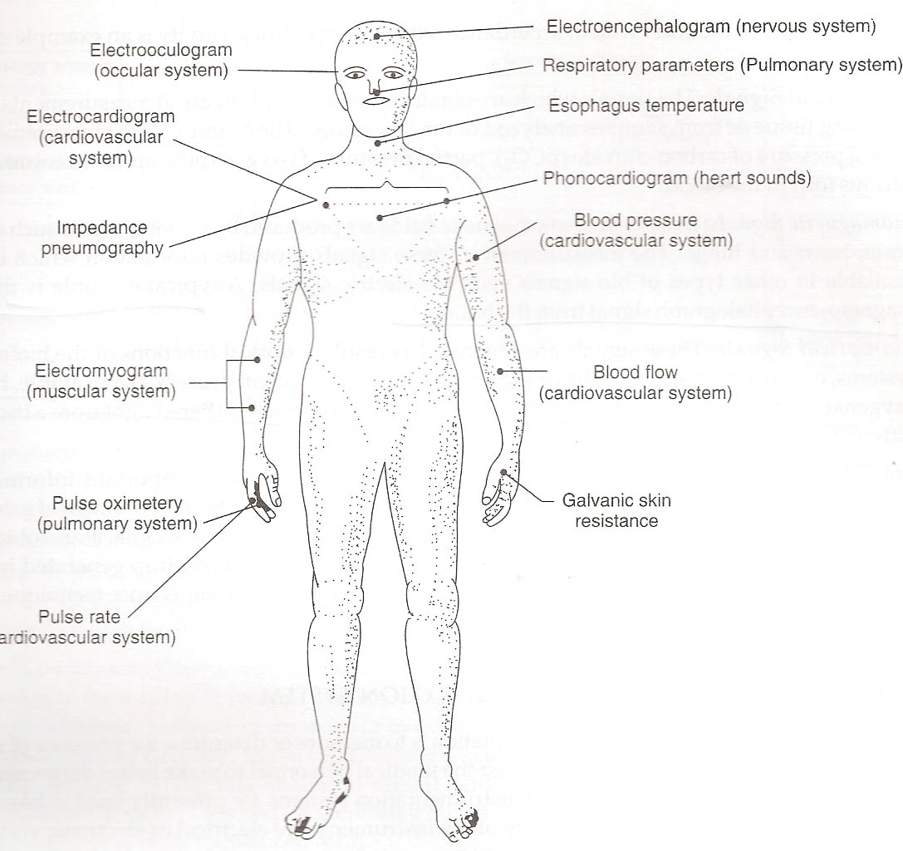

Slide 5
Medical and Physiological Parameters #1

Slide 6
Medical and Physiological Parameters #2

Slide 7
Medical and Physiological Parameters #3

Slide 8
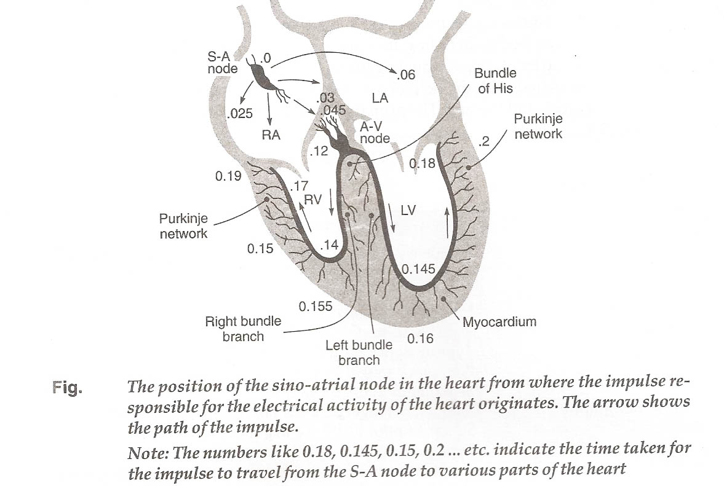

Slide 9
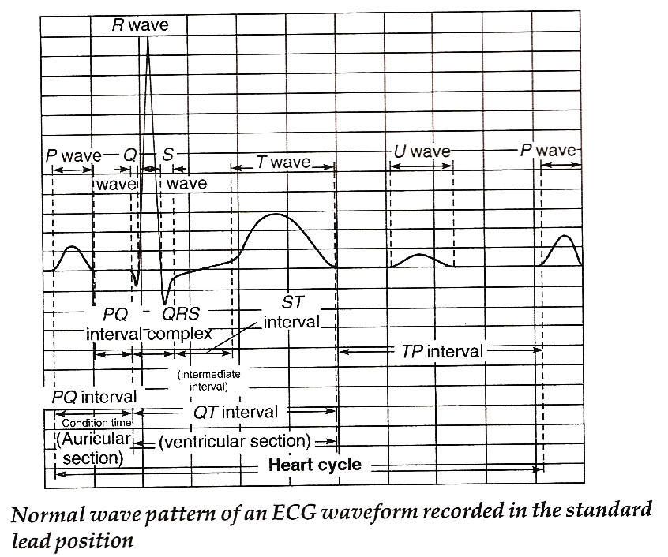

Slide 11
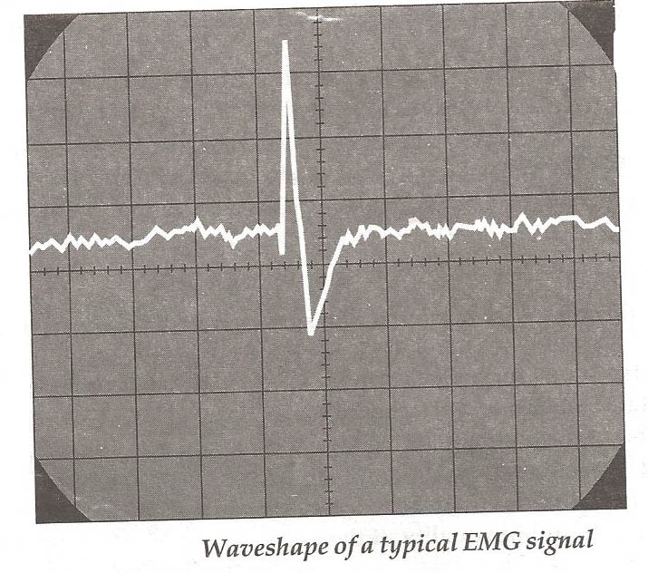

Slide 12
Generalized Instrumentation System
Control
And
feedback
Power
Sensor
source
Perceptible
output
Primary
Sensing
element
Variable
Conversion
element
Signal
processing
Output
display
Measurand
Calibration
Data
storage
Data
transmission
signal
Radiation,
electric current,
or other applied
energy
The sensor converts energy or information from the measurand to another form (usually electric). This signal is processed and displayed so that humans can perceive the information. Elements and connections shown by dashed lines are optional for some applications.

Slide 13
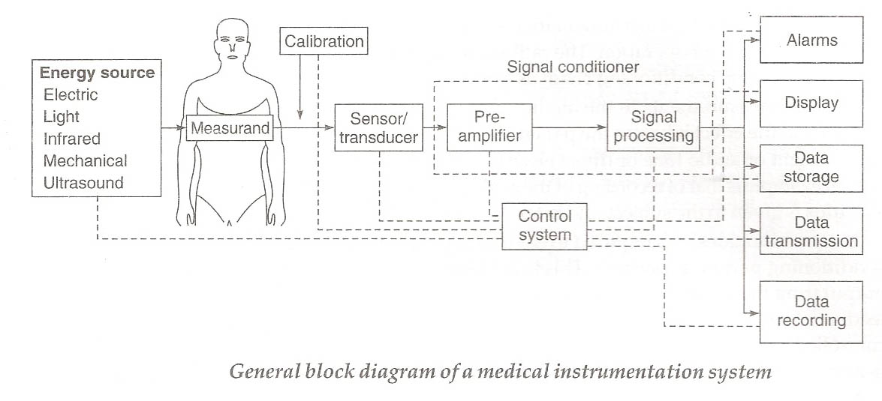

Slide 14
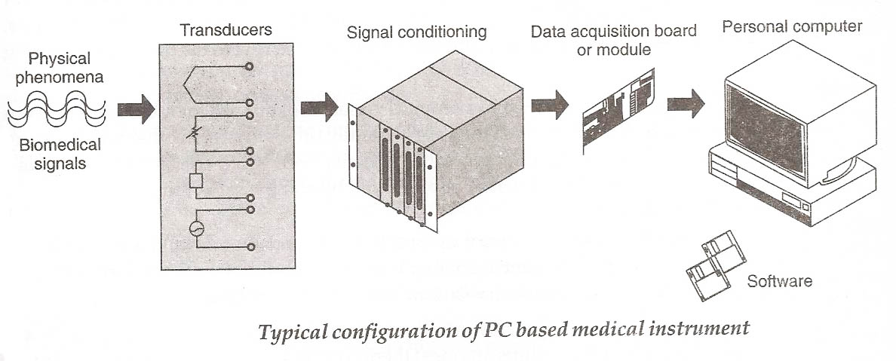

Slide 15
Generalized Static Characteristics of Instrumentation System
Accuracy
Difference between the true value and the measured value divided by the true value
True value is a traceable standard to NIST
Expressed as a percentage of the reading or of full scale, or ± the smallest analog division
Precision
Number of distinguishable alternatives (eg., a meter with a five digit readout)
Resolution
Smallest incremental quantity that can be measured with certainty
Reproducibility
Produces the same output for a given input over a period of time
Statistical Control
Systematic and bias error can be removed by calibration
Random errors can be removed by taking multiple measurements and averaging the results

Slide 16
Simplified Electrocardiographic Recording System
Electrodes
v_{ecg}
60-Hz
ac magnetic
field
+
V_{cc}
Z₁
Z_{body}
Z₂
+
Differential
amplifier
v_{o}
-
Displacement
currents
-V_{cc}
Two possible interfering inputs are stray magnetic fields and capacitively coupled noise. Orientation of patient cables and changes in electrode-skin impedance are two possible modifying inputs. Z₁ and Z₂ represent the electrode-skin interface impedances.

Slide 17
Basic Biopotential Amplifier Requirements
Purpose:
To provide voltage and/or current gain to increase the amplitude of weak electric signals of biological origin
Features:
High input impedance (minimize the loading effects of the amplifier inputs)
Protection circuitry (limit the possibility of introducing dangerous microshocks or macroshocks at the input terminals of the amplifier)
Low output impedance (low with respect to the load being driven)
Adequate output current (to supply the power needed to drive the load)
Bandlimited frequency response (match the frequency response of the signal being measured to eliminate out-of-band noise)
Quick calibration (include a signal source and a number of selectable fixed gains settings)
High common-mode rejection for differential amplifiers (common mode signals are frequently larger than the biopotentials being measured)
Additional specific requirements for each application

Slide 18
Biopotential Electrodes by Dr. Joyanta Kumar Roy

Slide 19
Biopotential Electrodes Outline
The Electrode-Electrolyte Interface
Polarization
Polarizable and Nonpolarizable Electrodes
Electrode Behavior & Circuit Models
The Electrode-Skin Interface & Motion Artifact
Body-Surface Recording Electrodes
Internal Electrodes
Electrode Arrays
Microelectrodes
Electrodes for Electric Stimulation of Tissue
Practical Hints in Using Electrodes

Slide 20
Biopotential Electrodes – The Basics
The interface between the body and electronic measuring devices
Conduct current across the interface
Current is carried in the body by ions
Current is carried in electronics by electrons
Electrodes must change ionic current into electronic current
This is all mediated at what is called the Electrode-Electrolyte Interface or the Electrode-Tissue Interface

Slide 24
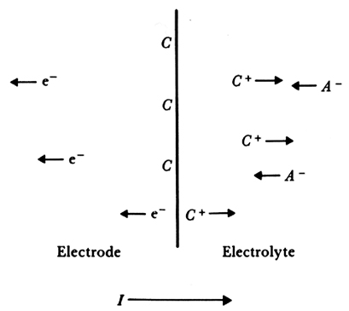
Current Flow at the Electrode-Electrolyte Interface
⬅ Ion⁻ flow
Electrons move in opposite direction to current flow
Cations (C⁺ ) move in same direction as current flow
Anions (A– ) move in opposite direction of current flow
Chemical oxidation (current flow right) - reduction (current flow left) reactions at the interface:
C C ⁺ + e – (5.1)
A – A + e – (5.2)
No current at equilibrium
⬅ Electron flow
Ion⁺ flow ➔
+ Current flow ➔
Figure 5.1 The current crosses it from left to right. The electrode consists of metallic atoms C. The electrolyte is an aqueous solution containing cations of the electrode metal C⁺ and anions A⁻.

Slide 25
Half-Cell Potential
When metal (C) contacts electrolyte, oxidation (C ➔ C ⁺ + e –) or reduction (A⁻ ⬅ A + e –) begins immediately.
Local concentration of cations at the surface changes.
Charge builds up in the regions.
Electrolyte surrounding the metal assumes a different electric potential from the rest of the solution.
This potential difference is called the half-cell potential ( E⁰ ).
Separation of charge at the electrode-electrolyte interface results in a electric double layer (bilayer).
Measuring the half-cell potential requires the use of a second reference electrode.
By convention, the hydrogen electrode is chosen as the reference.
J.K.Roy
25

Slide 26
Half-Cell Potentials of Common Metals at 25 ºC
Metal Potential E⁰ (volts)
Al - 1.706
Zn - 0.763
Cr - 0.744
Fe - 0.409
Cd - 0.401
Ni - 0.230
Pb - 0.126
H 0.000
AgCl + 0.223
Hg₂Cl₂ + 0.268
Cu + 0.522
Ag + 0.799
Au + 1.680
By definition: Hydrogen is bubbled over a platinum electrode and the potential is defined as zero.

Slide 27
Electrode Polarization
Standard half-cell potential ( E⁰ ):
Normally E⁰ is an equilibrium value and assumes zero-current across the interface.
When current flows, the half-cell potential, E⁰ , changes.
Overpotential ( V_{p} ):
Difference between non-zero current and zero-current half-cell potentials; also called the polarization potential (V_{p}).
Components of the overpotential ( V_{p} ):
Ohmic ( V_{r} ): Due to the resistance of the electrolyte (voltage drop along the path of ionic flow).
Concentration ( V_{c} ): Due to a redistribution of the ions in the vicinity of the electrode-electrolyte interface (concentration changes).
Activation ( V_{a} ): Due to metal ions going into solution (must overcome an energy barrier, the activation energy) or due to metal plating out of solution onto the electrode (a second activation energy).
V_{p} = V_{r} + V_{c} + V_{a} (5.4)

Slide 28
Nernst Equation
Governs the half-cell potential:
where
E – half-cell potential
E⁰– standard half-cell potential
(the electrode in an electrolyte with unity
activity at standard temperature)
R – universal gas constant [ 8.31 J/(mol K) ]
T – absolute temperature in K
n – valence of the electrode material
F – Faraday constant [ 96,500 C/(mol/valence) ]
– ionic activity of cation C^{n+}
(its availability to enter into a reaction)
(5.6)

Slide 29
Hydrogen Electrode
Standard Hydrogen Electrode (SHE)
The SHE is the universal reference for reporting relative half-cell potentials. It is a type of gas electrode and was widely used in early studies as a reference electrode, and as an indicator electrode for the determination of pH values. The SHE could be used as either an anode or cathode depending upon the nature of the half-cell it is used with. The SHE consists of a platinum electrode immersed in a solution with a hydrogen ion concentration of 1.00M. The platinum electrode is made of a small square of platinum foil which is Platonized (known as platinum black). Hydrogen gas, at a pressure of 1 atmosphere, is bubbled around the platinum electrode. The platinum black serves as a large surface area for the reaction to take place, and the stream of hydrogen keeps the solution saturated at the electrode site with respect to the gas. It is interesting to note that even though the SHE is the universal reference standard, it exists only as a theoretical electrode which scientists use as the definition of an arbitrary reference electrode with a half-cell potential of 0.00 volts. (Because half-cell potentials cannot be measured, this is the perfect electrode to allow scientists to perform theoretical research calculations.) The reason this electrode cannot be manufactured is due to the fact that no solution can be prepared that yields a hydrogen ion activity of 1.00M. hydrogen electrode is made by adding platinum black to platinum wire or a platinum plate. It is immersed in the test solution and an electric charge is applied to the solution and platinum black with hydrogen gas. The hydrogen-electrode method is a standard among the various methods for measuring pH. The values derived using other methods become trustworthy only when they match those measured using hydrogen electrode method. However, this method is not appropriate for daily use because of the effort and expense involved, with the inconvenience of handling hydrogen gas and great influence of highly oxidizing or reducing substances in the test solution.

Slide 30
Polarizability & Electrodes
Perfectly polarizable electrodes:
No charge crosses the electrode when current is applied
Noble metals are closest (like platinum and gold); they are difficult to oxidize and dissolve.
Current does not cross, but rather changes the concentration of ions at the interface.
Behave like a capacitor.
Perfectly non-polarizable electrodes:
All charge freely crosses the interface when current is applied.
No overpotential is generated.
Behave like a resistor.
Silver/silver-chloride is a good non-polarizable electrode.

Slide 31
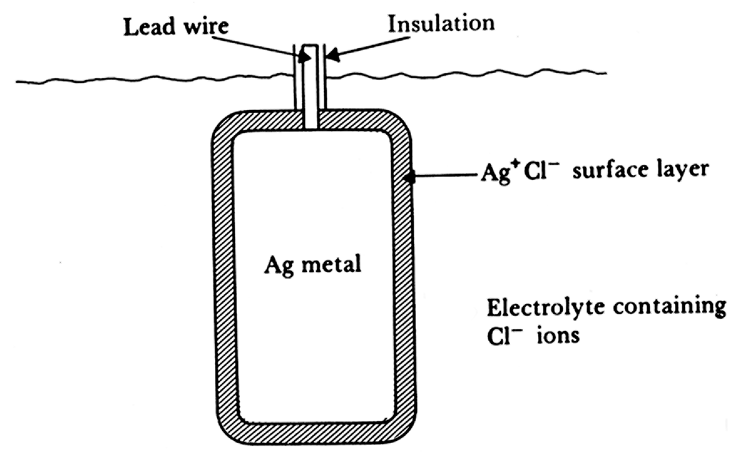
The Classic Ag/AgCl Electrodes
Features:
Practical electrode, easy to fabricate.
Metal (Ag) electrode is coated with a layer of slightly soluble ionic compound of the metal and a suitable anion (Cl).
Reaction 1: silver oxidizes at the Ag/AgCl interface
Ag Ag ⁺ + e – (5.10)
Reaction 2: silver cations combine with chloride anions
Ag ⁺ + Cl – Ag Cl (5.11)
AgCl is only slightly soluble in water so most precipitates onto the electrode to form a surface coating.
Figure 5.2 A silver/silver chloride electrode, shown in cross section.

Slide 32
Ag/AgCl Electrodes
Solubility product ( K_{s} ): The rate of precipitation and of returning to solution. At equilibrium:
K_{s} = a_{Ag+} x a_{Cl -} (5.12)
The equation for the half-cell potential becomes
E = E⁰_{Ag} + ln ( K_{s} ) - ln ( a_{Cl -} )
(5.15)
Determined by the activity of the chloride ion. In the body, the activity of Cl – is quite stable.
RT
nF
RT
nF
constant

Slide 33
Ag/AgCl Fabrication
Electrolytic process
Large Ag/AgCl electrode serves as the cathode.
Smaller Ag electrode to be chloridized serves as the anode.
A 1.5 volt battery is the energy source.
A resistor limits the current.
A milliammeter measures the plating current.
Reaction has an initial surge of current.
When current approaches a steady state (about 10 µA), the process is terminated.
A
Cathode Anode
Electrochemical Cell

Slide 34
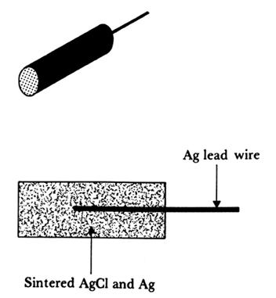
Sintered Ag/Ag Electrode
Sintering Process
A mixture of Ag and AgCl powder is pressed into a pellet around a silver lead wire.
Baked at 400 ºC for several hours.
Known for great endurance (surface does not flake off as in the electrolytically generated electrodes).
Silver powder is added to increase conductivity since AgCl is not a good conductor.
Figure 5.3

Slide 38
Calomel Electrode
Calomel is mercurous chloride (Hg₂Cl₂).
Approaches perfectly non-polarizing behavior
Used as a reference in pH measurements.
Calomel paste is loaded into a porous glass plug at the end of a glass tube.
Elemental Hg is placed on top with a lead wire.
Tube is inserted into a saturated KCl solution in a second glass tube.
A second porous glass plug forms a liquid-liquid interface with the analyte being measured.
Lead Wire
Hg
Hg₂Cl₂
K Cl
porous glass plug
Electrolyte being measured

Slide 39
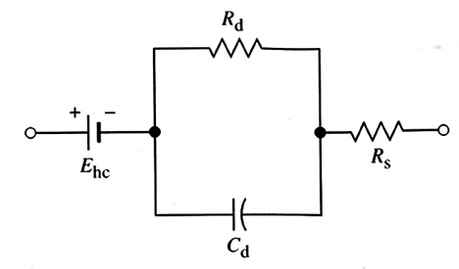
Electrode Circuit Model
E_{hc} is the half-cell potential
C_{d} is the capacitance of the electric double layer (polarizable electrode properties).
R_{d} is resistance to current flow across the electrode-electrolyte interface (non-polarizable electrode properties).
R_{s} is the series resistance associated with the conductivity of the electrolyte.
At high frequencies: R_{s}
At low frequencies: R_{d} + R_{s}
Figure 5.4

Slide 40
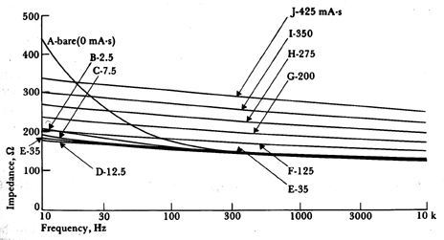
Ag/AgCl Electrode Impedance
Figure 5.5 Impedance as a function of frequency for Ag electrodes coated with an electrolytically deposited AgCl layer. The electrode area is 0.25 cm². Numbers attached to curves indicate the number of mA⋅s for each deposit.

Slide 41
Nichel- & Carbon-Loaded Silicone
Electrode area is 1.0 cm²
Figure 5.6

Slide 42
Skin Anatomy
Figure 5.7

Slide 43
Electrode-Skin Interface Model
E_{he}
Motion artifact:
Gel is disturbed, the charge distribution is perturbed changing the half-cell potentials at the electrode and skin.
Minimized by using non-polarizable electrode and mechanical abrasion of skin.
Skin regenerates in 24 hours.
Electrode
C_{d}
R_{d}
Sweat glands
Gel
R_{s}
and ducts
E_{se}
E_{P}
Epidermis
C_{e}
R_{e}
C_{P}
R_{P}
Dermis and
subcutaneous layer
R_{u}
Figure 5.8 A body-surface electrode is placed against skin, showing the total electrical equivalent circuit obtained in this situation. Each circuit element on the right is at approximately the same level at which the physical process that it represents would be in the left-hand diagram.

Slide 44
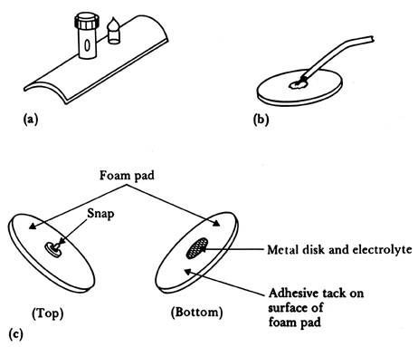
Metal Electrodes
Figure 5.9 Body-surface biopotential electrodes (a) Metal-plate electrode used for application to limbs. (b) Metal-disk electrode applied with surgical tape. (c) Disposable foam-pad electrodes, often used with electrocardiograph monitoring apparatus.

Slide 45
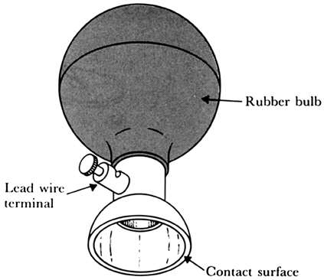
Metal Suction Electrodes
A paste is introduced into the cup.
The electrodes are then suctioned into place.
Ten of these can be with the clinical electrocardiograph – limb and precordial (chest) electrodes
Figure 5.10

Slide 46
Floating Metal Electrodes
Metal disk
Insulating
package
Mechanical technique to reduce noise.
Isolates the electrode-electrolyte interface from motion artifacts.
Double-sided
Adhesive-tape
ring
Electrolyte gel
in recess
(a)
(b)
Snap coated with Ag-AgCl
External snap
Gel-coated sponge
Plastic cup
Plastic disk
(c)
Foam pad
Tack
Dead cellular material
Capillary loops
Germinating layer
Figure 5.11 (a) Recessed electrode with top-hat structure. (b) Cross-sectional view of the electrode in (a). (c) Cross-sectional view of a disposable recessed electrode of the same general structure shown in Figure 5.9(c). The recess in this electrode is formed from an open foam disk, saturated with electrolyte gel and placed over the metal electrode.

Slide 47
Flexible Body-Surface Electrodes
Carbon-filled silicone rubber
(b) Flexible Mylar film with Ag/AgCl electrode
(c) Cross section of the Mylar electrode
Figure 5.12

Slide 48
Percutaneous Electrodes
Insulated needle
(b) Coaxial needle
(c) Bipolar coaxial needle
(d) Fine wire, ready for insertion
(e) Fine wire, after insertion
(f) Coiled fine wire, after insertion
Figure 5.13

Slide 49
Fetal Intracutaneous Electrodes
Suction needle electrode
Suction electrode (in place)
Helical electrode (attached by corkscrew action)
Figure 5.14

Slide 50
Implantable Electrodes
Wire-loop electrode
Cortical surface potential electrode
Figure 5.15
Multielement depth electrode array

Slide 51
Microfabricated Electrode Arrays
Insulated leads
Contacts
Electrodes
Contacts
Electrodes
Base
Insulated leads
Base
(b)
(a)
Exposed tip
Tines
Figure 5.16 (a) One-dimensional plunge electrode array (b) Two-dimensional array, and (c) Three-dimensional array
Base
(c)

Slide 52
Intracellular Recording Electrode
Figure 5.17
Metal needle with a very fine tip (less than 1.0 µm)
Prepared by electrolytic etching
Metal needle is the anode of an electrolytic cell, and is slowly drawn out of the electrolyte solution (difficult to produce)
Metal must have great strength: stainless steel, platinum-iridium, tungsten, tungsten carbide.

Slide 53
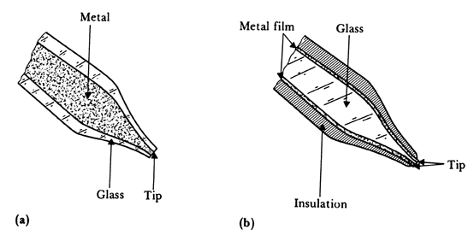
Supported Metal Electrodes
Figure 5.18 (a) Metal-filled glass micropipet. (b) Glass micropipet or probe, coated with metal film.

Slide 54
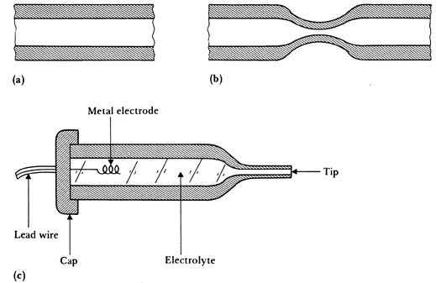
Glass Micropipet Electrodes
Figure 5.19 A glass micropipet electrode filled with an electrolytic solution (a) Section of fine-bore glass capillary. (b) Capillary narrowed through heating and stretching. (c) Final structure of glass-pipet microelectrode.

Slide 55
Microfabricated Microelectrodes
SiO₂ insulated
Au probes
Insulated
lead vias
Bonding pads
Exposed
electrodes
Silicon probe
Si substrate
Exposed tips
(a) Beam-lead multiple electrode
(b) Multielectrode silicon probe
Miniature
insulating
chamber
Channels
Silicon chip
Hole
Lead via
Silicon probe
Contact
metal film
Electrode
(c) Multiple-chamber electrode
(d) Peripheral-nerve electrode
Figure 5.20

Slide 56
Microelectrode Electrical Model
Cell
membrane
Insulation
Shaft
Metal rod
Submerged
shaft
N = Nucleus
C = Cytoplasm
Tissue fluid
+
+
Tissue
fluid
+
-
-
-
Membrane
potential
+
+
-
+
+
+
-
+
-
C
-
+
N = Nucleus
C = Cytoplasm
-
-
Shank in
tissue fluid
-
-
+
+
-
+
+
-
N
-
+
+
-
-
-
+
+
-
-
+
C
-
-
-
-
-
+
+
+
+
-
-
-
-
-
+
Shank
inside cell
+
+
+
+
+
Electrode tip
inside cell
Shank Capacitance:
Figure 5.21 (a) Electrode with tip placed within a cell, showing origin of distributed capacitance
(5.16)
e_{r}, e₀ = dielectric const.
D = avg. dia. of shank
d = dia. of electrode
t = thickness of
insulation layer
L = length of shank &
shaft, respectively
Submerged Shaft
Capacitance:
(5.17)

Slide 57
Microelectrode Electrical Model
A
Insulation
Metal rod
B
Figure 5.21
(a) Electrode with tip placed within a cell
Cell
membrane
C_{d}
Tissue fluid
+
+
Reference
electrode
+
-
-
-
Membrane
potential
N = Nucleus
C = Cytoplasm
+
-
+
+
-
C
-
-
+
+
-
-
+
+
-
N
-
-
+
+
-
-
-
-
-
+
+
+
+
-
-
-
-
-
+
+
+
+
+
+
Electrode
resistance
R_{s}
Lead wire
capacitance
A
(b) Equivalent circuit
C_{w}
To amplifier
C_{d2}
Shaft
capacitance
B
Metal-
electrolyte
interface
R_{ma}
C_{ma}
C_{mb}
R_{mb}
Reference
electrode
model
C_{d1}
C_{di}
E_{ma}
E_{mb}
R_{i}
E_{mp}
R_{e}
Tissue fluid
resistance
Cytoplasm
resistance
Cell
membrane
Shank
capacitance

Slide 58
Microelectrode Electrical Model
Figure 5.21
A
R_{s}
C_{w}
(b) Equivalent circuit
C_{d2}
B
R_{ma}
C_{ma}
C_{mb}
R_{mb}
C_{di}
E_{ma}
E_{mb}
R_{i}
E_{mp}
R_{e}
(c) Simplified equivalent circuit
R_{ma}
R_{s}, R_{i}, R_{e}, and R_{mb} are very
small compared to R_{ma}.
E_{mp}
Membrane
and
action
potential
A
C_{ma}
0
C_{d} + C_{w}
E
B
E_{ma} - E_{mb}

Slide 59
Glass Micropipet
A
B
A
To amplifier
B
Internal
electrode
R_{ma}
C_{ma}
Electrolyte
in
micropipet
E_{ma}
Glass
Internal
electrode
Stem
R_{t}
C_{mb}
C_{d}
R_{mb}
E_{j}
E_{mb}
Environmental
fluid
E_{t}
Taper
Reference
electrode
R_{i}
R_{e}
Tip
C_{d}
(b)
E_{mp}
Reference
electrode
Cell
membrane
+
+
+
+
+
+
-
-
-
-
-
+
+
-
-
-
-
+
R_{t} = electrolyte resistance in shank & tip
C_{d} = capacitance from micropipet
electrolyte to environmental fluid
E_{j} = liquid-liquid junction potential
between micropipet electrolyte &
intracellular fluid
E_{t} = tip potential generated by the thin
glass membrane at micropipet tip
R_{i} = intracellular fluid resistance
E_{mp} = cell membrane potential
R_{e} = extracellular fluid resistance
+
-
N
-
+
+
-
Cytoplasm
N = Nucleus
-
-
+
+
+
-
-
-
-
-
(a)
+
+
-
-
+
+
+
+
Cell membrane
Figure 5.22 (a) Electrode with its tip placed within a cell, showing the origin of distributed capacitance. (b) Equivalent circuit.

Slide 60
Glass Micropipet
A
B
R_{t}
A
R_{ma}
C_{ma}
Membrane
and
action
potential
0
C_{d} = C_{t}
E_{ma}
E_{mp}
E_{m}
R_{t}
C_{mb}
B
C_{d}
R_{mb}
(c)
E_{j}
E_{mb}
E_{m} = E_{j} + E_{t} + E_{ma}- E_{mb}
E_{t}
(b)
R_{i}
R_{e}
R_{t} = all the series resistance lumped together
(ranges from 1 to 100 MW)
C_{t} = total distributed capacitance lumped
together (total is tens of pF)
E_{m} = all the dc potentials lumped together
Behaves like a low-pass filter.
E_{mp}
Figure 5.22 (b) Equivalent circuit. (c) Simplified equivalent circuit.

Slide 61
Figure 5.23 (a) Constant-current stimulation (b) Constant-voltage stimulation Charge transfer characteristics of the electrode are very important. Platinum black and Iridium oxide are very good stimulating electrode materials.
Stimulating Electrodes
i
t
v
Polarization
potential
Ohmic
potential
Polarization
potential
t
(a)
v
t
i
Polarization
Polarization
t
(b)

Slide 62
Practical Hints in Using Electrodes
Ensure that all parts of a metal electrode that will touch the electrolyte are made of the same metal.
Dissimilar metals have different half-cell potentials making an electrically unstable, noisy junction.
If the lead wire is a different metal, be sure that it is well insulated.
Do not let a solder junction touch the electrolyte. If the junction must touch the electrolyte, fabricate the junction by welding or mechanical clamping or crimping.
For differential measurements, use the same material for each electrode.
If the half-cell potentials are nearly equal, they will cancel and minimize the saturation effects of high-gain, dc coupled amplifiers.
Electrodes attached to the skin frequently fall off.
Use very flexible lead wires arranged in a manner to minimize the force exerted on the electrode.
Tape the flexible wire to the skin a short distance from the electrode, making this a stress-relief point.

Slide 63
Practical Hints in Using Electrodes
A common failure point in the site at which the lead wire is attached to the electrode.
Repeated flexing can break the wire inside its insulation.
Prove strain relief by creating a gradual mechanical transition between the wire and the electrode.
Use a tapered region of insulation that gradually increases in diameter from that of the wire towards that of the electrode as one gets closer and closer to the electrode.
Match the lead-wire insulation to the specific application.
If the lead wires and their junctions to the electrode are soaked in extracellular fluid or a cleaning solution for long periods of time, water and other solvents can penetrate the polymeric coating and reduce the effective resistance, making the lead wire become part of the electrode.
Such an electrode captures other signals introducing unwanted noise.
Match your amplifier design to the signal source.
Be sure that your amplifier circuit has an input impedance that is much greater than the source impedance of the electrodes.

